Slide 1
LOOKUP Functions

Slide 2
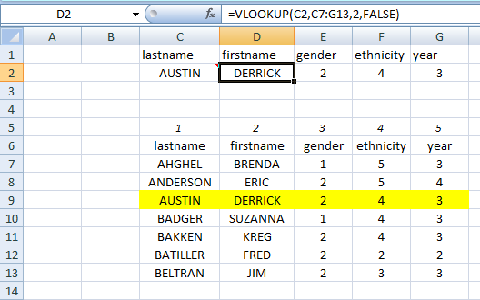
Column C should b in ascending order. Lets find firstname C2 is for AUSTIN, C7:G13 is range of data. 2 is the column number from left FALSE stands for EXACT MATCH [If TRUE or omitted, nearest match will be returned]
Try with TRUE or
omit

Slide 3
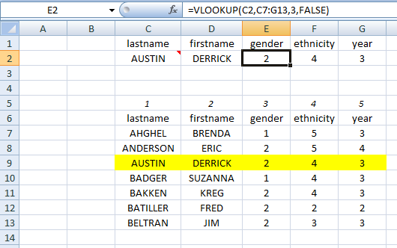
Column C should b in ascending order. Lets find gender C2 is for AUSTIN, C7:G13 is range of data. 3 is the column number from left FALSE stands for EXACT MATCH [If TRUE or omitted, nearest match will be returned]

Slide 4
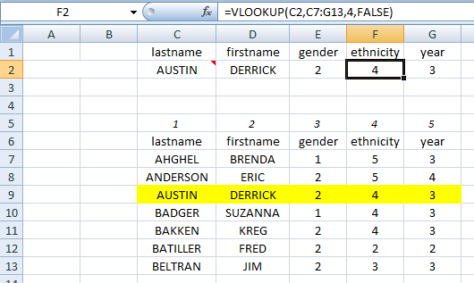
Column C should b in ascending order. Lets find ethnicity C2 is for AUSTIN, C7:G13 is range of data. 4 is the column number from left FALSE stands for EXACT MATCH [If TRUE or omitted, nearest match will be returned]

Slide 5
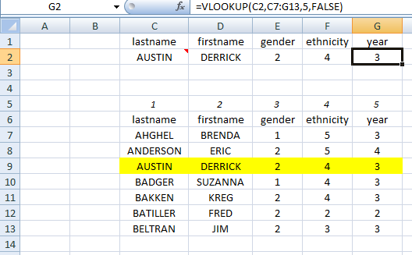
Column C should b in ascending order. Lets find year C2 is for AUSTIN, C7:G13 is range of data. 5 is the column number from left FALSE stands for EXACT MATCH [If TRUE or omitted, nearest match will be returned]

Slide 6
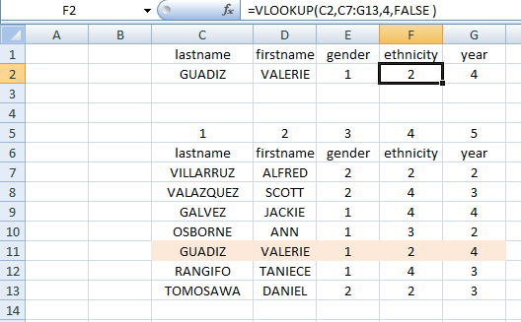
Interesting: If you are writing FALSE, NO need to have 1st column in ascending order!

Slide 7
A case when you DO NOT want to be Exact (don’t want to use FALSE)

Slide 8
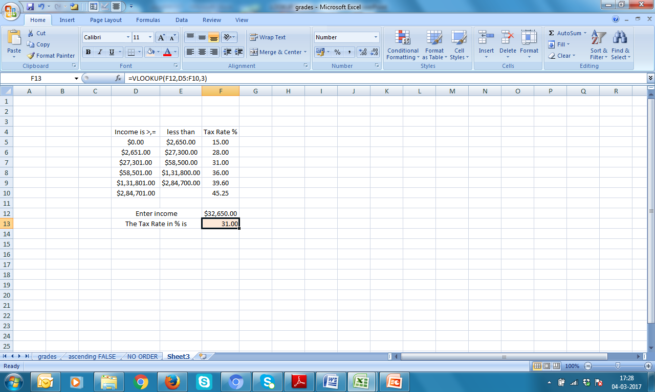
Find Tax Rate for a given income

Slide 9
F12 is the income, D5:F10 is the range of the data, 3 is the column number from left

Slide 10

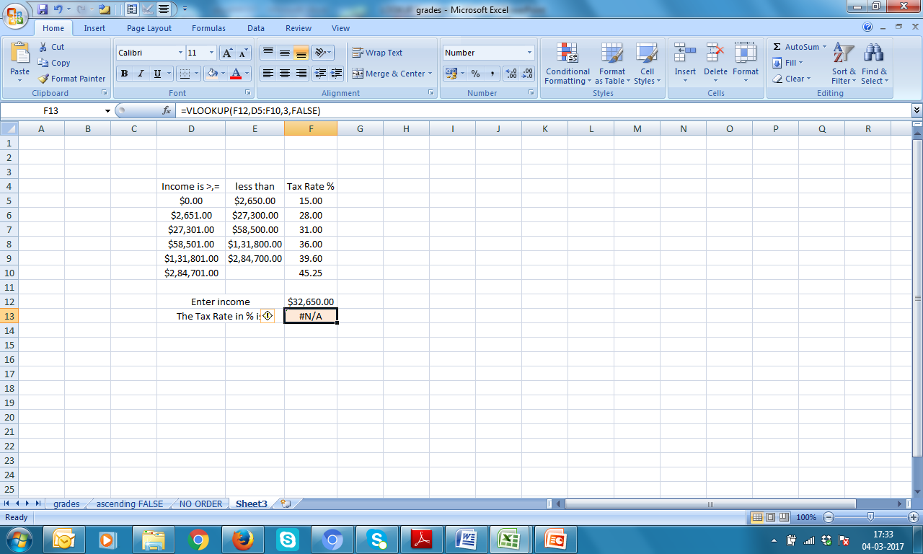
FALSE

Slide 11
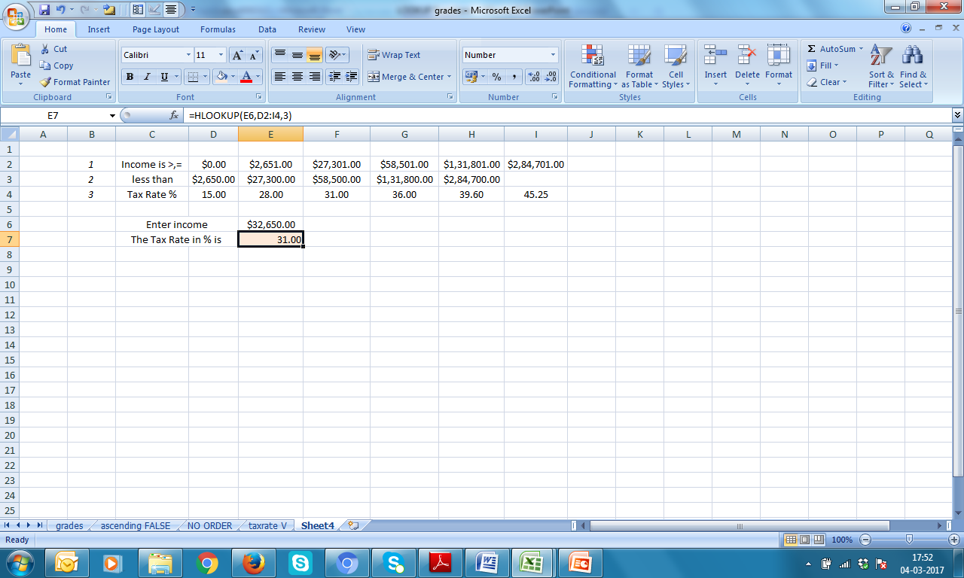
HLOOKUP Table is row-wise, indexing number will be now ROW NUMBER (3 in this case)

Slide 12
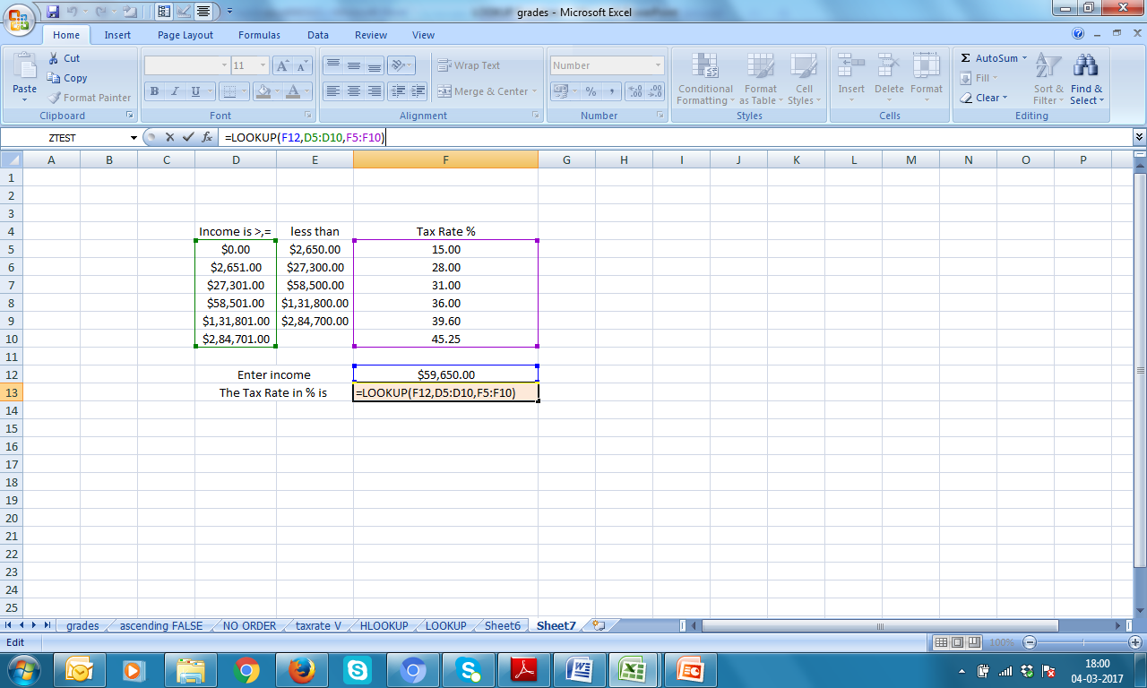
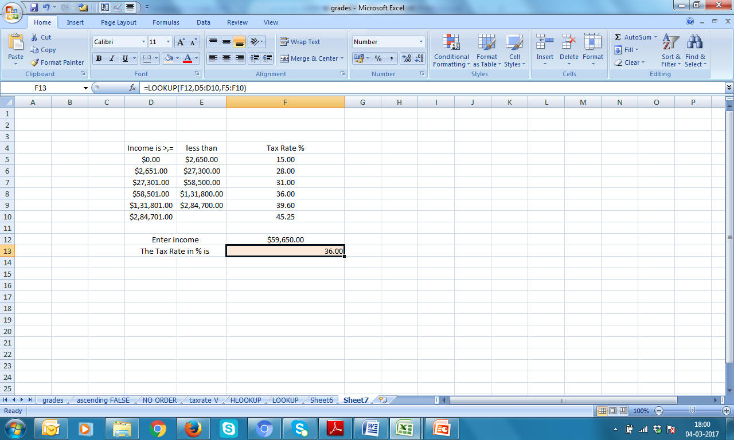
LOOKUP Contains two data ranges

Slide 13

LOOKUP Contains two data ranges

Slide 14
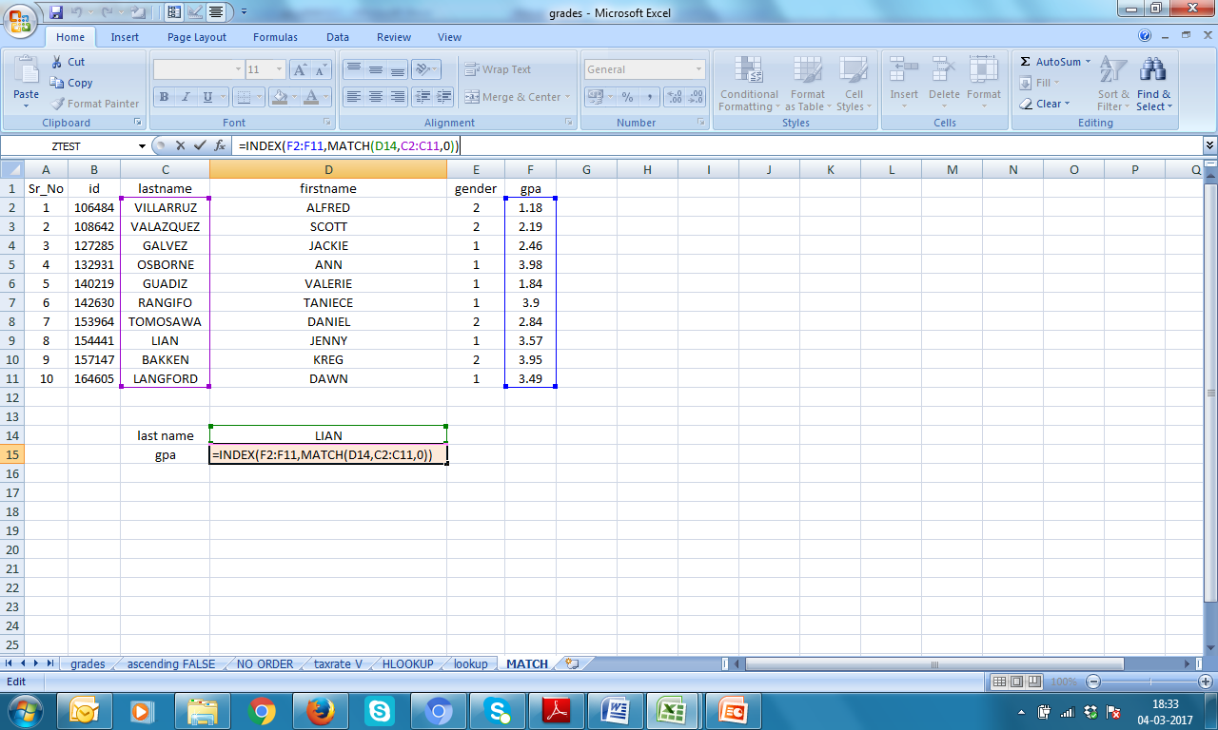
Alternate to LOOKUP INDEX & MATCH 0 stands for EXACT [Avoid 1 and -1 for time being]

Slide 15
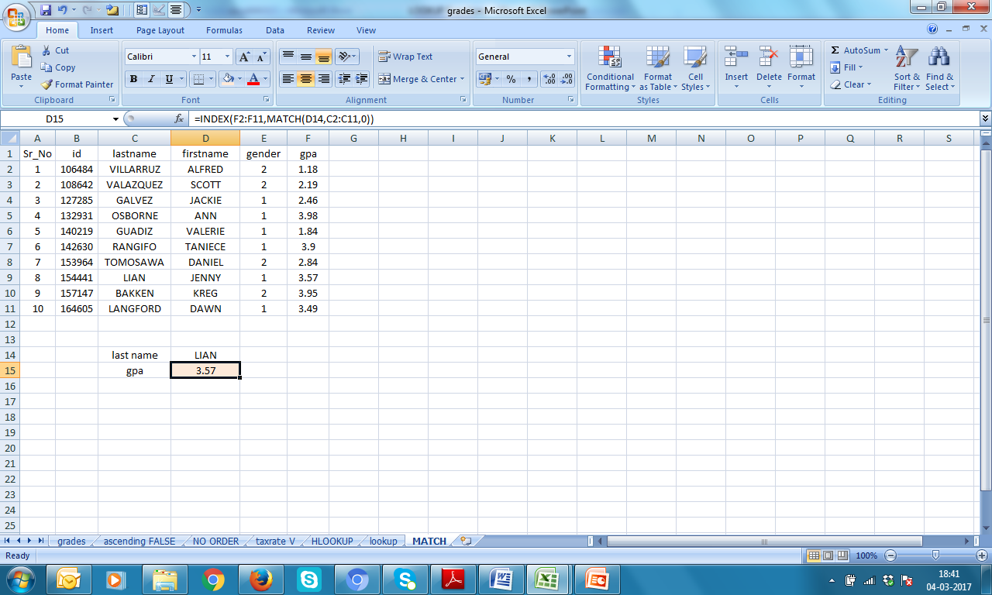
INDEX & MATCH

Slide 16
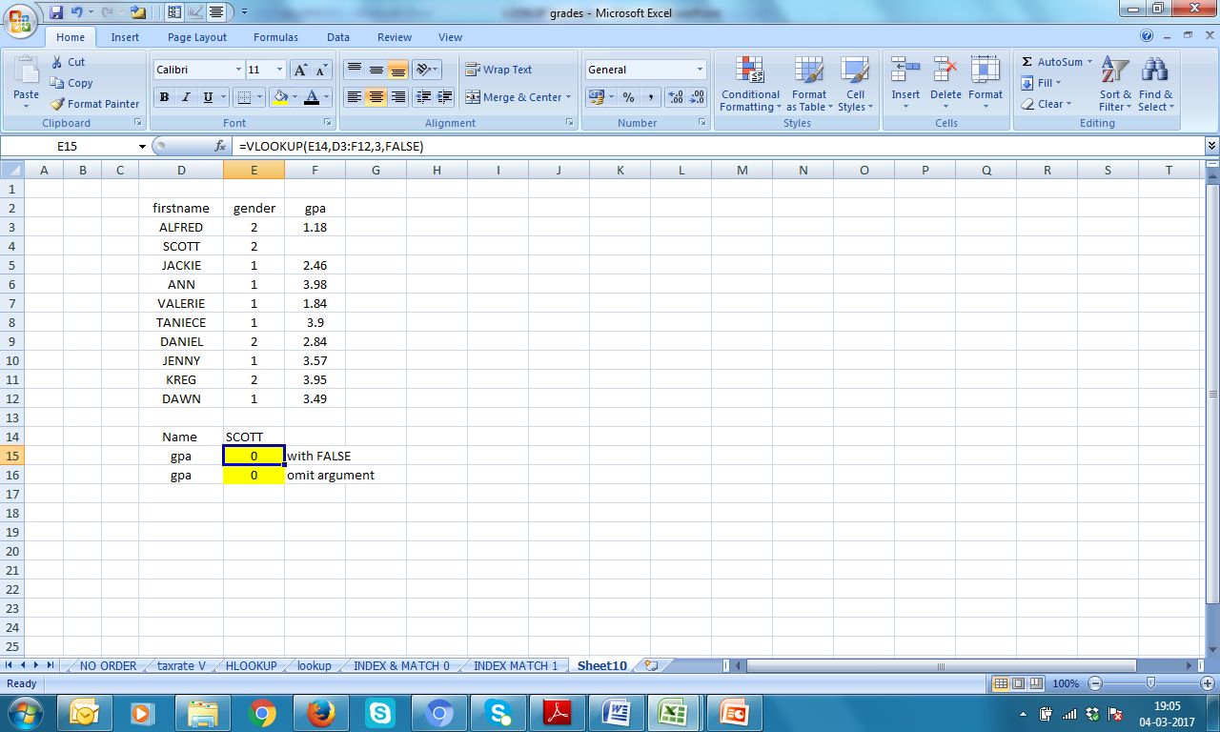
VLOOKUP When a cell is empty!

Slide 17
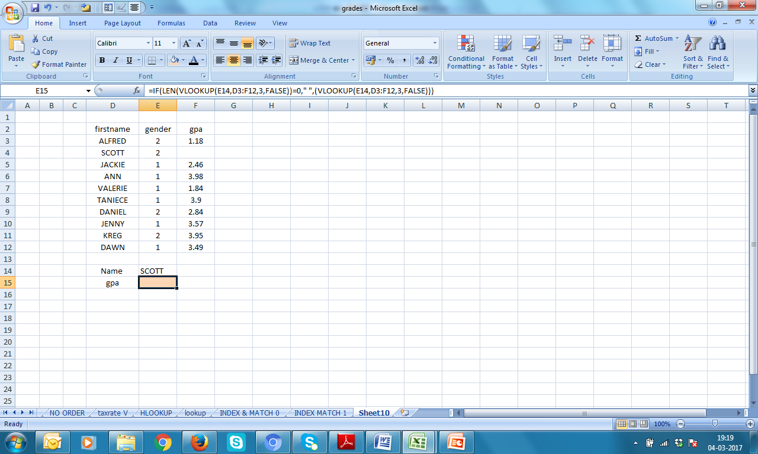
Modify VLOOKUP formula
If LENGTH of the return of
VLOOKUP(E14,D3:F12,3,FALSE) is 0
(which was actually!), then, write nothing,
Else, return the values as per
VLOOKUP(E14,D3:F12,3,FALSE)

Slide 18
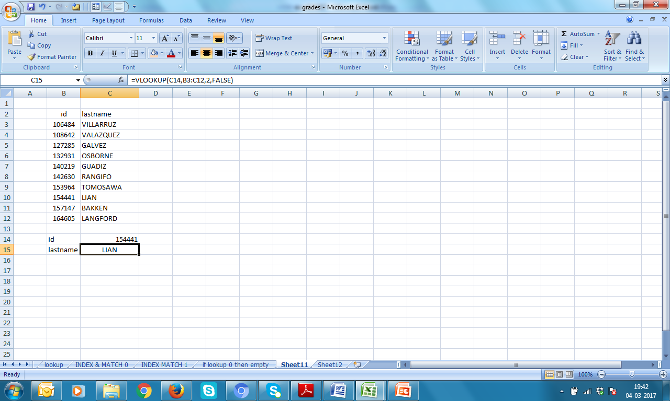
Number not found!

Slide 19
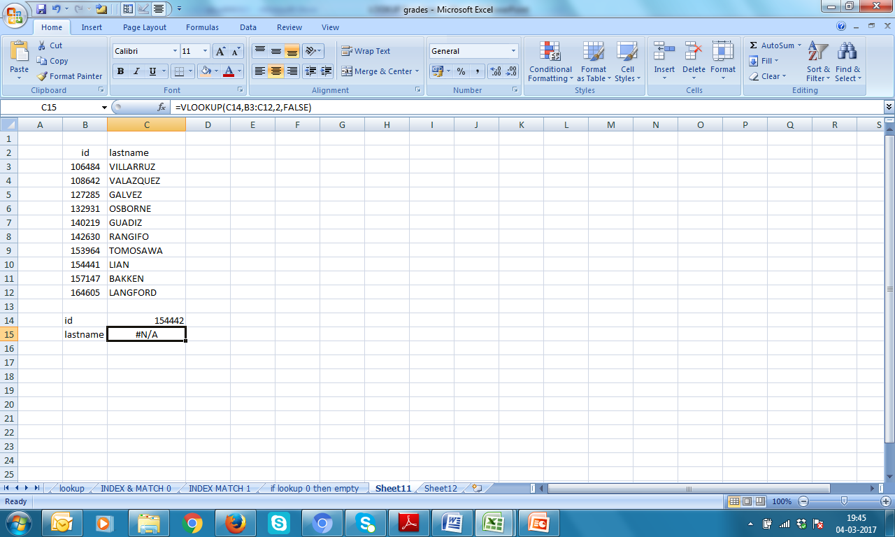

Number not found! Lets type 154442 in cell C14

Slide 20
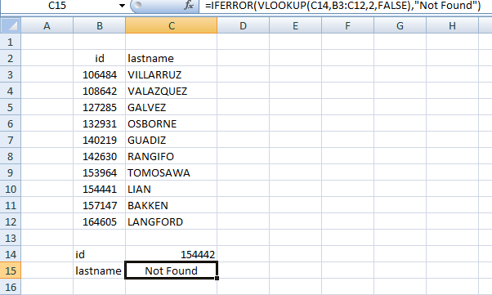
IFERROR
=IFERROR(VLOOKUP(C14,B3:C12,2,FALSE),"Not Found“)

Slide 21
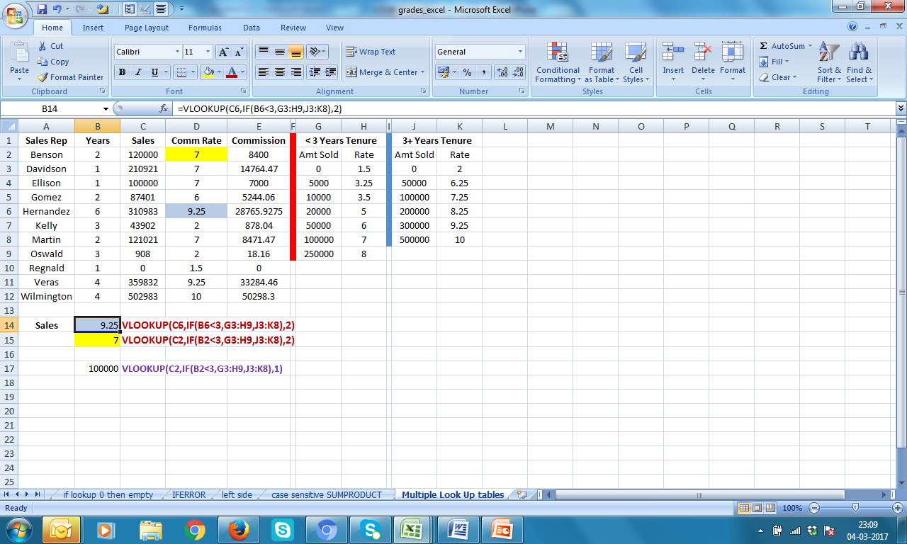
Multiple Tables
VLOOKUP(C2,IF(B2<3,G3:H9,J3:K8),2)

Slide 22
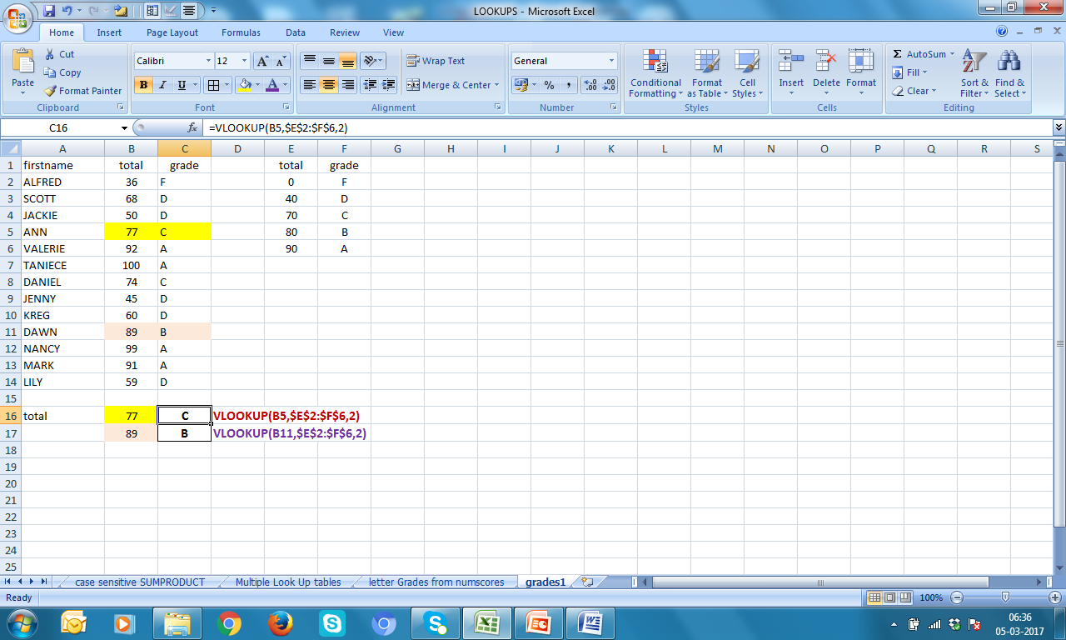
VLOOKUP From total to grades

Slide 23
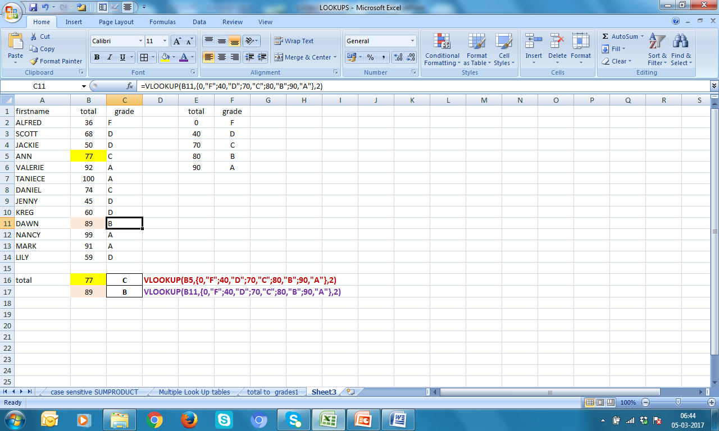
VLOOKUP Total to Grades another approach-2 (if table is small)

Slide 24

LOOKUP Total to Grades another approach-3 (if table is small)

Slide 25
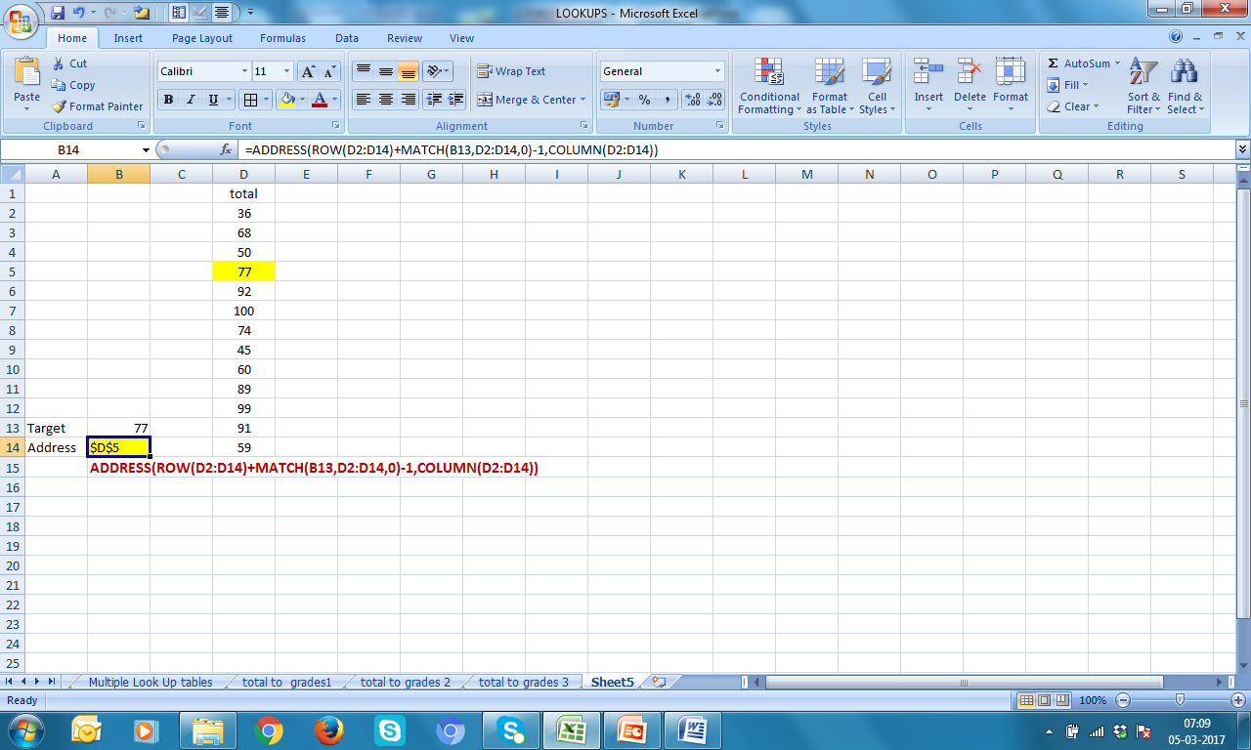
Finding cell address

